Slide 1



Hosted By:

Slide 2








Thank you to today’s sponsors!

Slide 3
POLICY AND PROGRAM
MODELS FOR
CREATING
ACCESSORY
DWELLING
UNITS
IN NEW HAMPSHIRE
Greater Seacoast Housing Summit
November 2nd, 2023
NHHousing.org

Slide 4
Why ADUs?
As a Housing Solution...
A lot has changed in the economy and housing affordability is at a low
The inability to build sufficient housing presents a risk the economy
Heath assessments identify housing as a key need for better outcomes
ADUs offer a lower cost alternative to traditional forms of housing production.

Slide 5
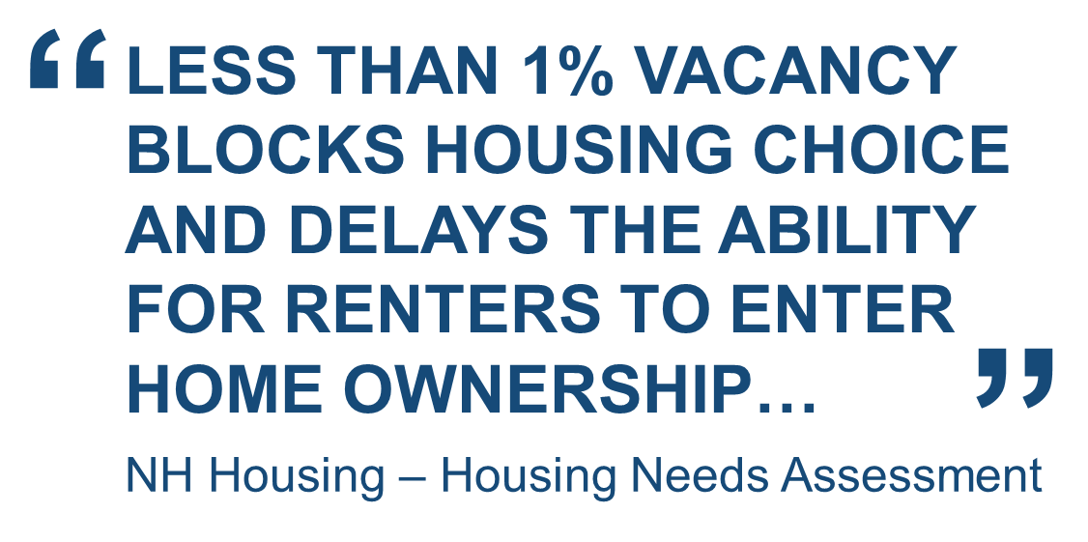

Declining Supply
Notes:
The need for ADUs was underscored in the 2023 NH Statewide Housing Needs Assessment, which found that the state’s current housing shortage to be over 23,500 UNITS, and that nearly 90,000 UNITS are needed between 2020 and 2040.

Slide 6


Mismatch Between Households and Homes
Fewer People in Households… More Bedrooms in Homes
28% of households have one person
15% of homes have less than two bedrooms.
Source: U.S. Census Bureau, Current Population Survey, March and Annual Social and Economic Supplements.
Source: U.S. Dept. of Commerce, Index of Housing Characteristic Tables

Slide 7
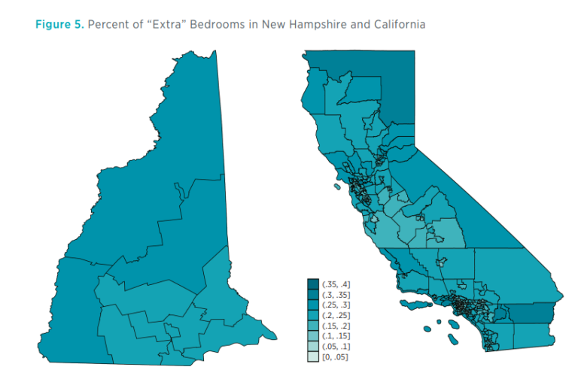
Mismatch Between Households and Homes
Fewer People in Households… More Bedrooms in Homes
Recent Mercatus Institute Study noted more than one-third of all households in New Hampshire have an extra bedroom in their home.
  For Example:
  (3 Bedrooms for a 2 Person HH)

Slide 8
Smaller Households and Larger Homes
Average Household Size increased 50%, is this sustainable?
The Long-term Trend of Larger Homes is Flattening Out
Source: U.S. Census 5-year ACS Data, Median SF Floor Area New SF Homes

Slide 9
ADU Opportunity
 | Economic | Social | Environmental | Governance
Owners | Additional Revenue | Flexible Use of Space Over Time | More Efficient Use of Property | Buy-In for Housing Solutions
Renters | Rental Options in New Locations | Community Attachment | Living closer to Destinations | Relationships with Homeowners
Families | Costs of Housing Family vs. Alt. | Multi-Generation Living | Fewer Cul-de-Sacs | Resilience to Misfortunes
Seniors | Cost Effective Downsizing | Ability to Age In Place | Reduced Home Emissions | Retained Autonomy
General | Adds Value to Land | Addresses Housing Demand | Uses Existing Infrastructure | Grows Local Economies

Slide 10
A Large Untapped Market
Few ADUs, Many Homeowners
.
(Survey) 86% of NH Residents 45 and older support making it easier for homeowners to create an ADU
Source: AARP 2020 Vital Voices Survey

Slide 11
Where are the Challenges with ADUs?
Pre-development Pit-falls
Homeowners need to take the initial risk on an ADU project
Hiring professionals and obtaining permits is costly
  Obtaining board approvals and permits can be 20% of the budget
    Hiring professionals and paying fees does not grantee a board approval
      20% of the project budget may be 100% of a homeowner's cash
        All this before a shovel even goes in the ground!
      For the average homeowner…
It is too risky!

Slide 12
What is an ADU?
Unit Limiting Language
New Hampshire Law...
RSA 674:72 - Sec. I
“…shall allow accessory dwelling units as a matter of right or by either conditional use permit pursuant to RSA 674:21 or by special exception…”
RSA 674:71
ADU Definition:
A residential living unit that is within or attached to a single-family dwelling, and that provides independent living facilities for one or more persons, including provisions for sleeping, eating, cooking, and sanitation on the same parcel of land as the principal dwelling unit it accompanies.
RSA 674:72 - Sec. VI
“A municipality may require owner occupancy of one of the dwelling units, but it shall not specify which unit…”
RSA 674:73 - “A municipality is not required to but may permit detached accessory dwelling units. If a municipality allows detached accessory dwelling units, it may require an increased lot size.
Notes:
In 2017, the New Hampshire Accessory Dwelling Units statute (RSA 674:72) became law as the state’s public officials recognized that ADUs are an important component to expanding the state’s severely insufficient housing supply. The law states that local governments are required to allow attached ADUs on any property where a single-family home is allowed to be built. They also are allowed to offer additional options for ADU construction, including detached ADUs and multiple ADUs.

Slide 13
ADUs Held Back…
National ADU Poison Pills
1.
Owner-Occupancy Requirements:
Typically enforced through a deed restriction. This creates complications for lenders which translates to increased risks.
Off-Street Parking Requirements:
On many lots, the prospect of adding a new parking space is not feasible.
Conditional Use Permit Hearings:
The process is often intimidating and costly. Hearing fees and hiring design professionals can cost over $6,000 and may be declined
2.
3.
Notes:
In 2017, the New Hampshire Accessory Dwelling Units statute (RSA 674:72) became law as the state’s public officials recognized that ADUs are an important component to expanding the state’s severely insufficient housing supply. The law states that local governments are required to allow attached ADUs on any property where a single-family home is allowed to be built. They also are allowed to offer additional options for ADU construction, including detached ADUs and multiple ADUs.

Slide 14
Recommendations
Easing NH Regulations
Policy Strategies to Increase ADU Production
1. Change state ADU definition to include detached ADUs:
2. Make attached and detached ADUs an “As-Of-Right” use:
3. Override local off-street parking requirements:
4. Eliminate owner-occupancy requirements:
Notes:
In 2017, the New Hampshire Accessory Dwelling Units statute (RSA 674:72) became law as the state’s public officials recognized that ADUs are an important component to expanding the state’s severely insufficient housing supply. The law states that local governments are required to allow attached ADUs on any property where a single-family home is allowed to be built. They also are allowed to offer additional options for ADU construction, including detached ADUs and multiple ADUs.

Slide 15

ADU Research
NHHousing.org/ADU
POLICY AND PROGRAM MODELS FOR CREATING ACCESSORY DWELLING UNITS…
explores policies and programs implemented in other states to encourage and support the creation of Accessory Dwelling Units (ADUs).
ADU TOOLS, AND TECHNIQUES…
are presented in this report for New Hampshire and its cities and towns to reference as they develop their own regulations and programs to stimulate the creation of this much-needed type of housing.

Slide 16







Research Focus
Affordability
Pre-Approved Plans
Design Initiatives

Slide 17



Affordability
Affordability
Pre-Approved Plans
Design Initiatives
Barnstable – Loan Program Designed to Give Amnesty to Informal Existing Units
Boston – Loan Program Designed to Support Piloted Zoning Changes.
California – Grant Program to Boost ADUs as an Affordable Housing Solution
Eugene – Created ADU Plans & Pre-Approved the Plans for Public Use
Chico - Purchased ADU Plans & Pre-Approved the Plans for Public Use
Seattle - Solicited ADU Plans for Pre-Approval & Arranged for Licensed Use
Los Angeles – Community Design Organization Uses ADUs for Public Discourse
Houston – Planning Dept. Hosts ADU Competition to Engage the Public
Salt Lake – City Partners with AIA to Host Design Competition for New Ideas

Slide 18

Barnstable, MA
Goal:
“…to provide an opportunity to bring into compliance many of the currently unpermitted accessory apartments and apartment units ….”
And to…
“… allow the construction of affordable housing.”
The Loan Program
Eligibility – Permit / Lease / Income
Loan Terms – Contract / Lien / 0% Deferred
Expenses – Code Compliance / Three Quotes
Monitoring – Fair & Open Rental / Income / Lease

Slide 19
Pre-Approved Plans
Affordability
Pre-Approved Plans
Design Initiatives
Barnstable – Loan Program Designed to Give Amnesty to Informal Existing Units
Boston – Loan Program Designed to Support Piloted Zoning Changes.
California – Grant Program to Boost ADUs as an Affordable Housing Solution
Eugene – Created ADU Plans & Pre-Approved the Plans for Public Use
Chico - Purchased ADU Plans & Pre-Approved the Plans for Public Use
Seattle - Solicited ADU Plans for Pre-Approval & Arranged for Licensed Use
Los Angeles – Community Design Organization Uses ADUs for Public Discourse
Houston – Planning Dept. Hosts ADU Competition to Engage the Public
Salt Lake – City Partners with AIA to Host Design Competition for New Ideas

Slide 20
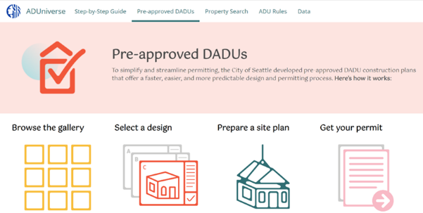




Seattle, WA
ADU Plan Solicitation
Designers can charge a maximum fee of $1,000 for licensing their pre-approved plan on website.
Homeowners engage in a licensing agreement with the design professional.
Designers retain ownership of plan sets they make available on the ADUniverse.

Slide 21
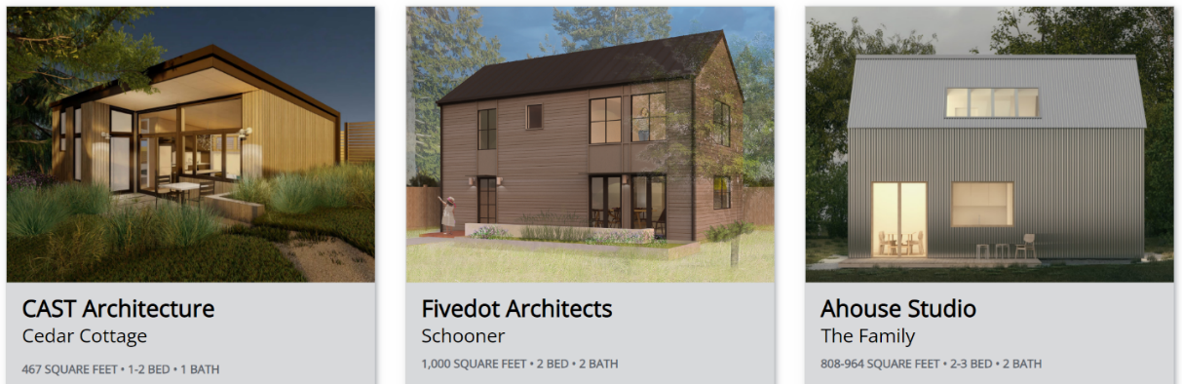
Seattle, WA
ADUniverse Website
Pre-Approved ADU Plans are available through Seattle’s ADUniverse Website
All ADU Plan Submissions to the City from the solicitation process are also available.

Slide 22
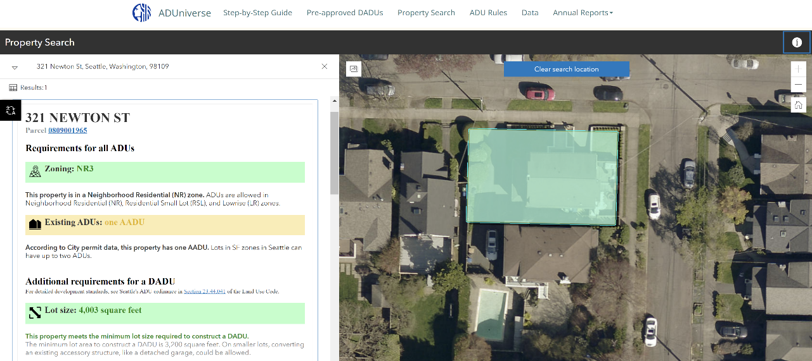
Seattle, WA
ADUniverse Website

Slide 23
Design Initiatives
Affordability
Pre-Approved Plans
Design Initiatives
Barnstable – Loan Program Designed to Give Amnesty to Informal Existing Units
Boston – Loan Program Designed to Support Piloted Zoning Changes.
California – Grant Program to Boost ADUs as an Affordable Housing Solution
Eugene – Created ADU Plans & Pre-Approved the Plans for Public Use
Chico - Purchased ADU Plans & Pre-Approved the Plans for Public Use
Seattle - Solicited ADU Plans for Pre-Approval & Arranged for Licensed Use
Los Angeles – Community Design Organization Uses ADUs for Public Discourse
Houston – Planning Dept. Hosts ADU Competition to Engage the Public
Salt Lake – City Partners with AIA to Host Design Competition for New Ideas

Slide 24

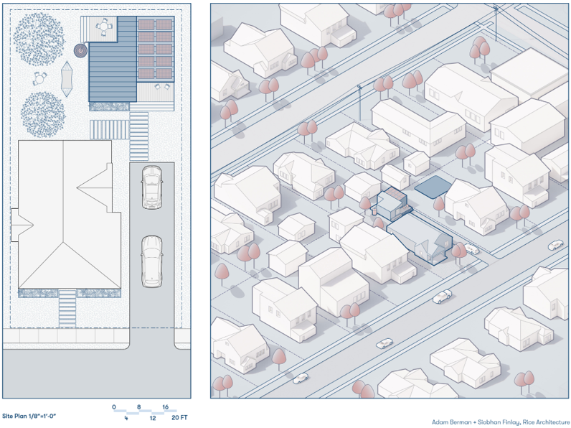
Houston, TX
ADU Design Competition
Community Discussion:
Housing Planning Dept. hosts “Lets Talk Houston” website to engage public in housing and ADU discussion
Received AARP Community Challenge Grant to pay for ADU competition awards
Leveraged plan submissions to put together ADU design book for public use

Slide 25





Successful Policies and Programs
IMPORTANT NOTE…
Liberalizing of ADU regulations and/or the ADU approval process was observed as an initial step in all the ADU case studies.
Identified ADU Tools & Techniques
Technical Assistance
Outreach & Education
DESIGN
Initiatives
Pre-Approved ADU Plans
Financial Incentives
Permitting & Approvals
ADU Checklist
Homeowner Workshops
Annual Reporting
Informational Videos
ADU Design Guides
Competitions
Pilot Projects
Free Plans for Public Use
License Fee for Plan Use
Loans & Grants
For Design & Permitting
Construction

Slide 26

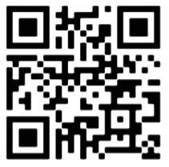
Successful Policies and Programs
Tools and Techniques for Increasing ADUs in NH
ADU Production Tool Case Study Location | Barnstable MA | Boston MA | State of CA | Eugene OR | Chico CA | Seattle WA | Los Angeles CA | Houston TX | Salt Lake UT
1 Reductions in Zoning: Regs/Approval Process | X | X | X | X1 | X1 | X1 | X1 |  | X1
2 Technical Assistance: Permitting/Approvals | X | X | X |  |  | X | X
3 Technical Assistance: Permitting Checklist |  | X
4 Technical Assistance: Homeowner Workshops |  | X |  |  |  |  |  | X
5 Annual Reporting: ADU Production |  |  | X | X |  | X | X |  | X
6 ADU Design Initiatives: ADU Design Guides |  |  | X |  |  | X | X |  | X
7 ADU Design Initiatives: Design Competition |  |  |  |  |  | X | X | X | X
8 ADU Design Initiatives: Pilot ADU Project |  |  |  |  |  |  | X
9 Pre-Approved Plans: Free for Public Use |  |  |  | X | X
10 Pre-Approved Plans: License Fee for Plan Use |  |  |  | X |  | X | X
11 Financial Incentives: ADU Design/Permit |  |  | X |  | X1 |  | X1
12 Financial Incentives: ADU Construction | X | X
Policy and Program Models for Creating Accessory Dwelling Units in New Hampshire
was written by Southern New Hampshire Planning Commission on behalf of New Hampshire Housing. Download the full report via the QR or go to NHHousing.org/ADU. To learn more about how your community or you can help support the development of ADUs, contact New Hampshire Housing.

Slide 27
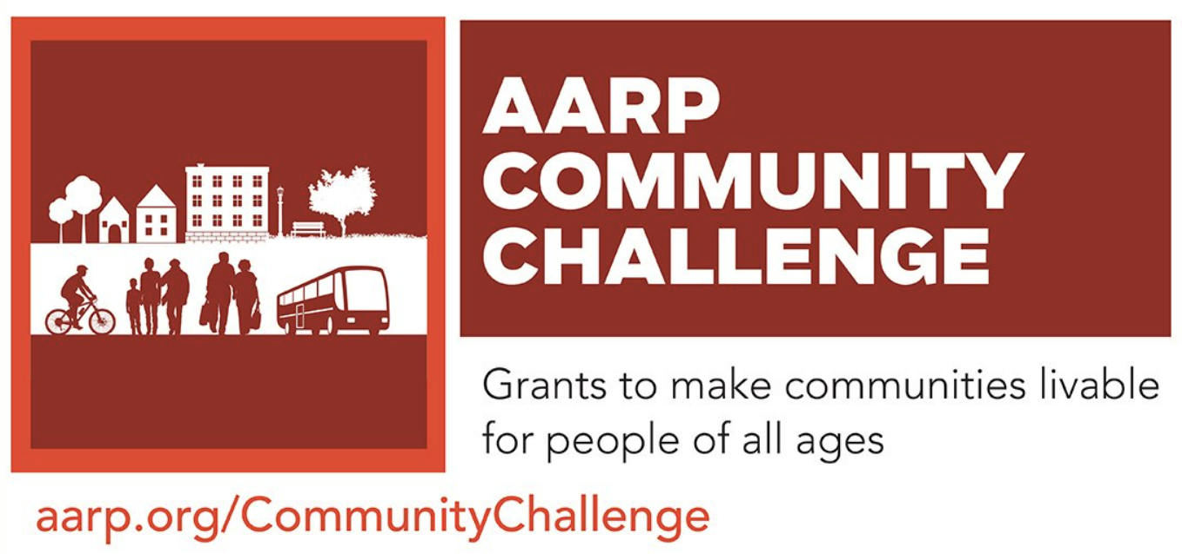

Scenario A:
Design Competition
Municipality Applies for AARP Grant
Grant to Fund Award for Competition:
Community surveyed for ADU preferences
Town hosts design competition
ADU plans selected by committee based on preferences and winners announced
Town applies for CDFA Capacity Building or HOP Grant to establish a pre-approved ADU plans library and revise local ADU regs
ADU competition winners are contracted to prepare ADU plans to a stamped and ready for approval level of detail for the town

Slide 28
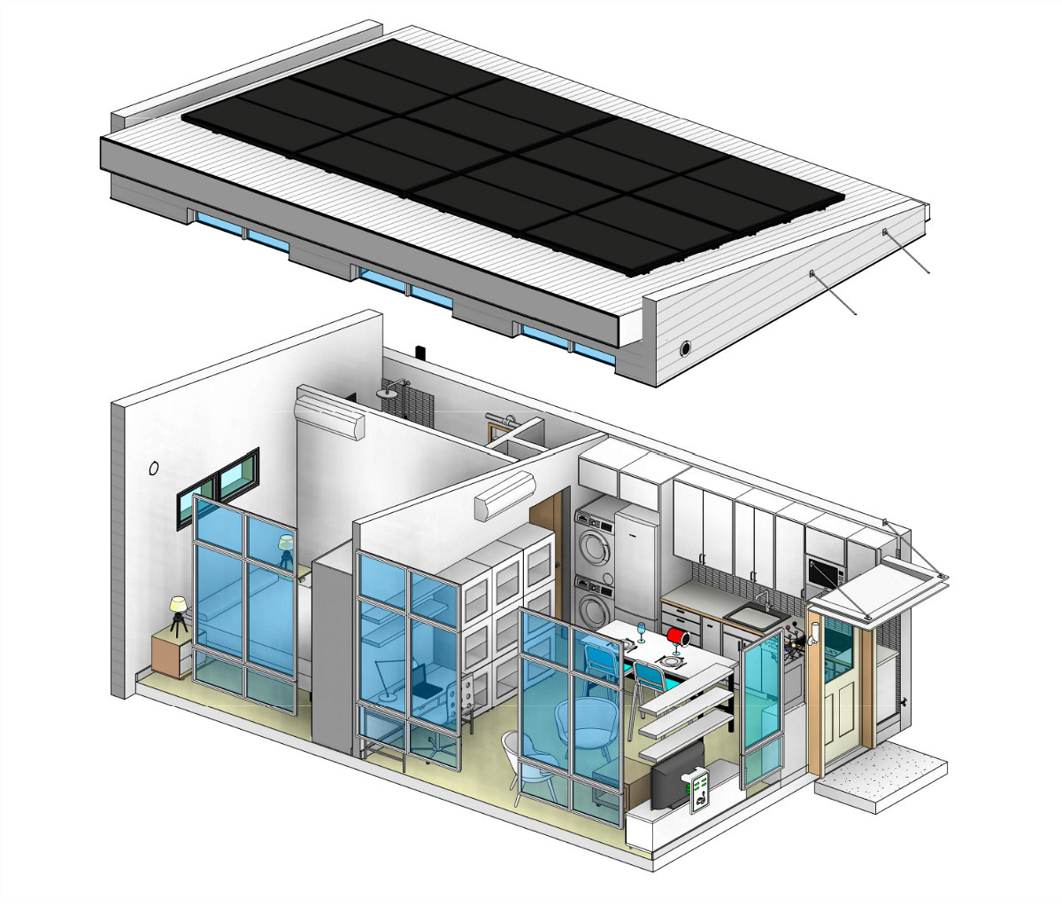
Scenario B:
Plans Cooperation
Regional Pre-Approved ADU Library
Planning Commission Leadership:
Seek interest from towns collaborating on a region wide pre-approved ADU plans library
Survey to residents in participating towns to determine criteria in selecting plans
Local officials coordinate on documentation needed for plans achieve pre-approval
Pre-Approved ADU plans provided to public via online library, plans can be used for a small licensing fee to plan creator

Slide 29
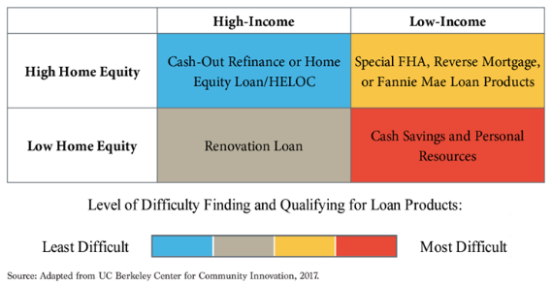
Scenario B:
0% Deferred Loans
State Housing Entity Supports ADUs
Loan Assistance for ADU Affordability:
Loans require no payments from homeowner while they remain in home
Income limits on the owner to qualify for the loan OR the renter to occupy the unit.
Comparatively cost-effective way for housing entities to support affordable units
Programs need large initial capitalization, but can sustain ongoing lending activity
Targeting Lending Tools for Impact

Slide 30

Scenario C:
State ADU Grant
State Legislation can Fund ADU Grants
Fund Pre-Development Costs:
ADU grants of $40k can support the cost of design, permitting, approvals, and sitework
Funds targeted to working class household, typically a group with limited capacity to absorb the high risk of pre-development
Grants are a fast-acting way to jumpstart industry and normalize ADU production
A Right Sized grant
California has 40 million residents (for $100M)
Replicating California’s ADU grant program at the scale of New Hampshire’s population, (1.4 million) puts things into perspective.
$4
Million
$40k
Per HH
100
New ADUs

Slide 31
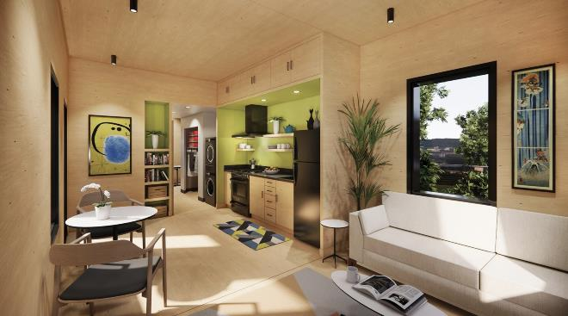
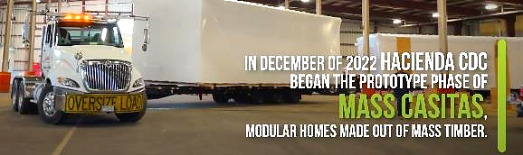
Bonus Scenario:
State ADU Pilot
State Legislation to Fund ADU Pilot
Fund Mass-Production Pilot:
Work with community development corporation to build 6 prototype units
Project includes the design, construction, delivery and testing of prototype homes
Controlled environments for production result in quality construction outcomes
Scaling of production reduces unit costs for materials and equipment
Low costs can lead to market viability and support building innovation

Slide 32
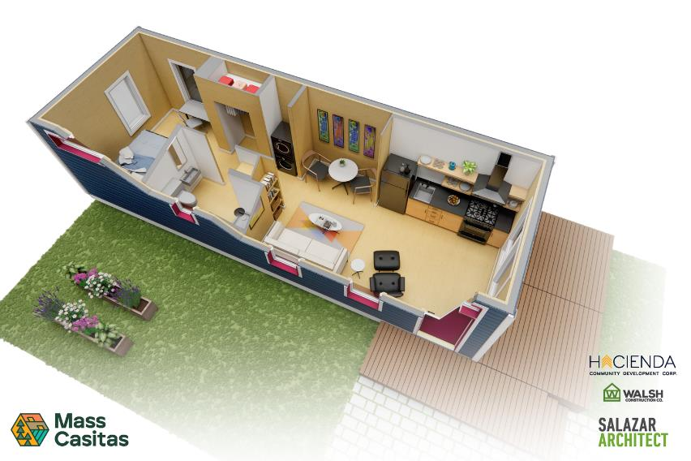
What’s Possible?
Replicate Innovative Projects
Hacienda CDC, led a pilot project to demonstrate how modular housing built with mass timber could provide a more efficient, faster, and less expensive way to build housing.
The pilot was provided $5M in funding by the Oregon Legislature.
Project then received a $44M grant from EDA for growing an emerging market for new timber products

Slide 33
Contact Us
New Hampshire Housing
603-472-8623
info@nhhfa.org
NHHousing.org
Southern NH Planning Commission
603-669-4664
email@snhpc.org
SNHPC.org
James Vayo, Author / Lead Researcher
617-908-4608
james.vayo@gmail.com
NHHousing.org/ADU
Policy and Program Models for Creating Accessory Dwelling Units in New Hampshire was written by Southern New Hampshire Planning Commission on behalf of New Hampshire Housing. Download the full report via the QR or go to NHHousing.org/ADU. To learn more about how your community or you can help support the development of ADUs, contact New Hampshire Housing.

Slide 35
Thank you to today’s sponsors!

