Slide 1
Housing and Smart Growth
Nick Taylor
Executive Director
Workforce Housing Coalition of the Greater Seacoast
Durham Housing Task Force
October 2023

Slide 2
OUR MISSION
Our mission is to educate and engage communities and municipalities to advance diverse housing options.
We envision an ample supply of affordable, desirable housing throughout the seacoast region of New Hampshire, providing opportunities for members of the workforce and all families and individuals, to put down roots and create a more diverse and equitable community that benefits us all. OUR WORK
We work with communities to support diverse housing options attainable to our workforce through community engagement, education, and technical assistance.

Slide 3
Housing Challenges: How Did We Get Here?
Economic conditions & influences
Supply, demand, interest rates
Demographic Shifts
Smaller families, increase in single person households
Desire to age in place
Demand for similar housing options among younger and older generations
Local resistance to housing development
Some land use regulations that are overly restrictive and exclusive

Slide 4
Five L’s of Housing Development
LUMBER Development costs
LABOR Workforce availability
LAND Finite, but intensity of use is variable
Lending Financing
LAWS Regulatory practices

Slide 5
Housing and Environment
Not opposing forces
Share a common enemy (sprawl)
Planning for housing, without planning for conservation (and vice versa) ensures the two will be in conflict
The key is be thoughtful about where.

Slide 6
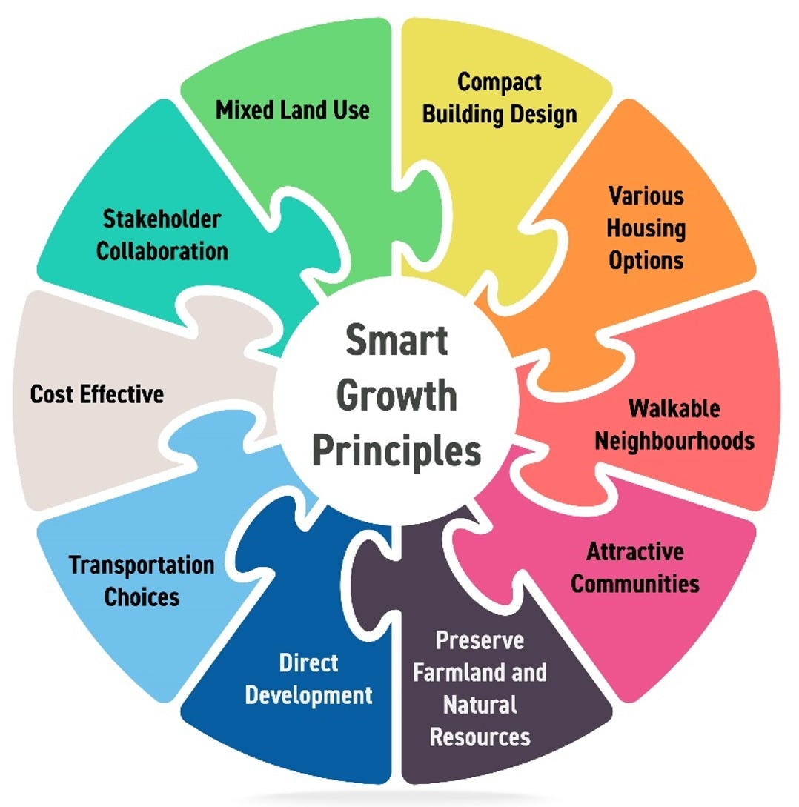
Smart Growth
Smart Growth America’s 10 Principles includes creating a range of housing opportunities and preserving open space.
RSA 9-B NH legislation addressing smart growth
Location, location, location

Slide 7
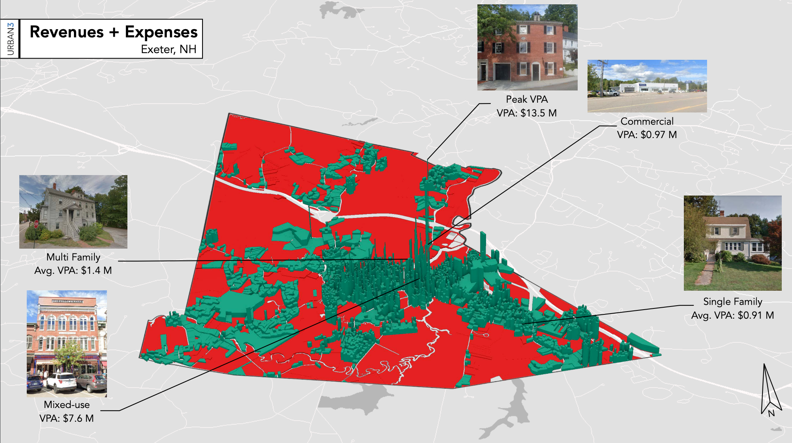
Smart Density: Economic Win-Win
Sprawl is expensive...roads, water, sewer, services all cost money
Mixed-use and multi-family development has the highest value per acre
Single family has the lowest
Most communities generate revenue from downtown
Source: Urban3 Land Value Analysis for New Hampshire Housing

Slide 8
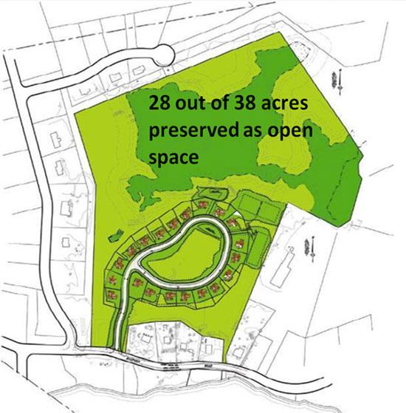
Housing and Conservation: Policy Examples
Conservation Subdivision
Compact design
Infill development
Accessory dwelling units
Adaptive reuse
Density is good for the environment
Fewer cars, more open space, AND more affordable!

Slide 9
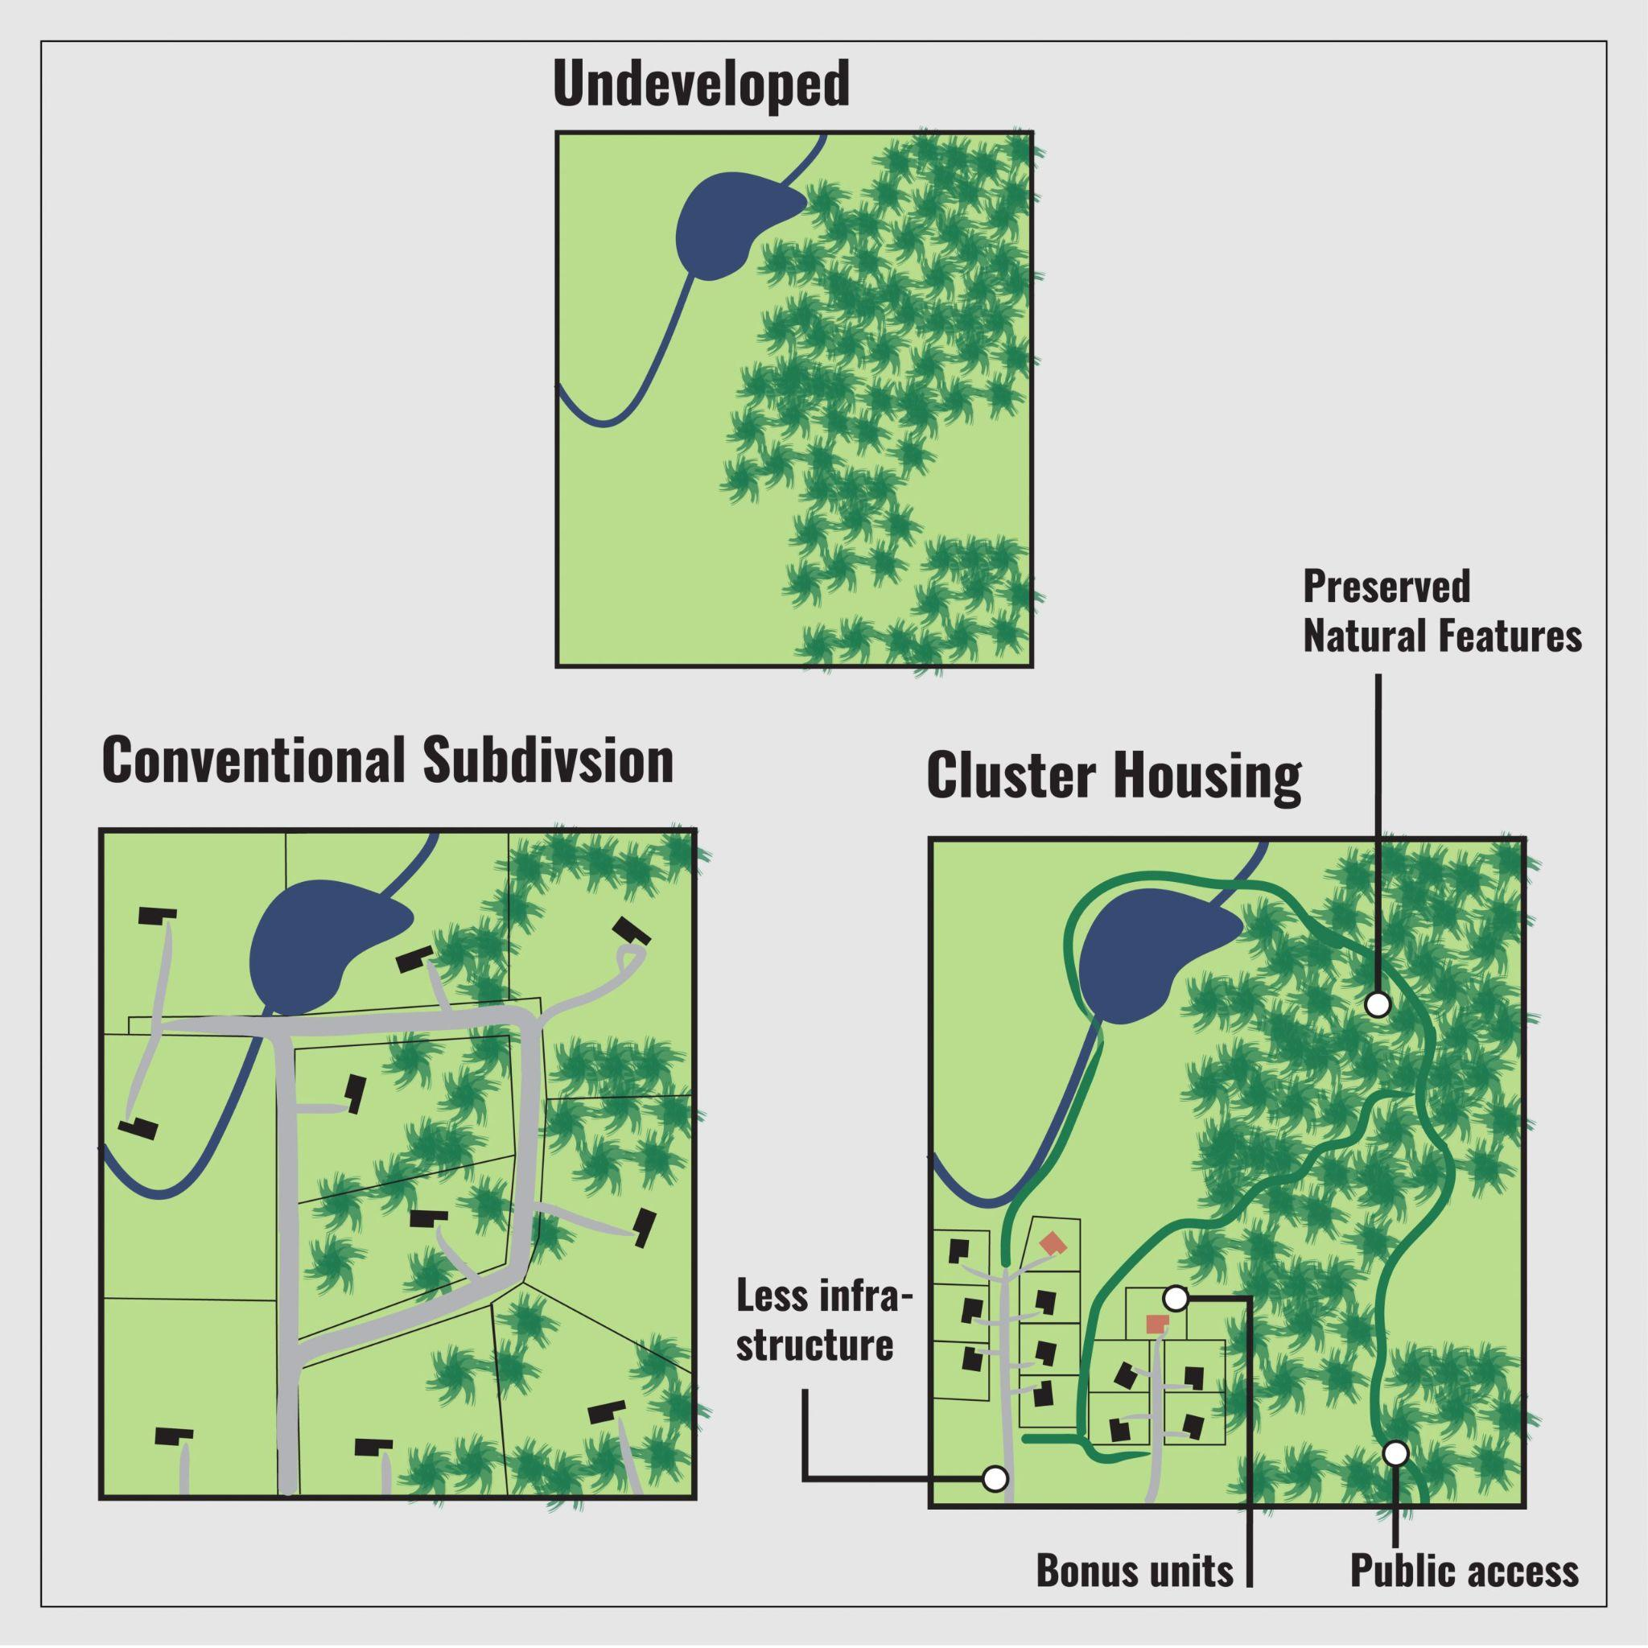
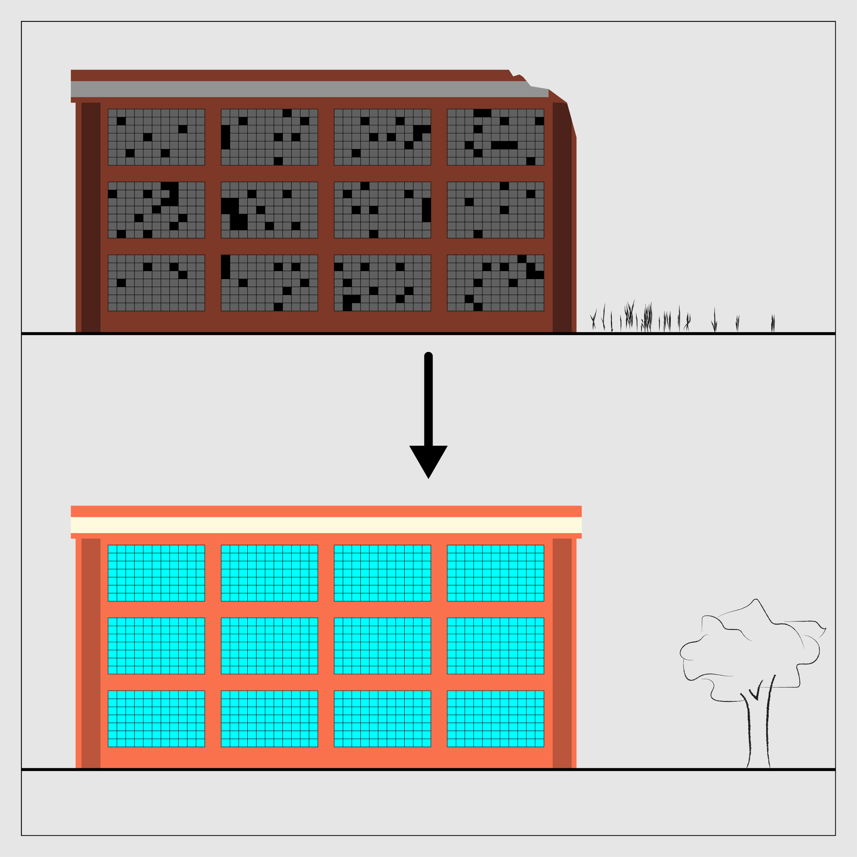
New Hampshire Housing Toolbox: Sustainable Housing
Cluster Housing
Adaptive Reuse
Source: New Hampshire Office of Planning and Development Housing Toolbox

Slide 10
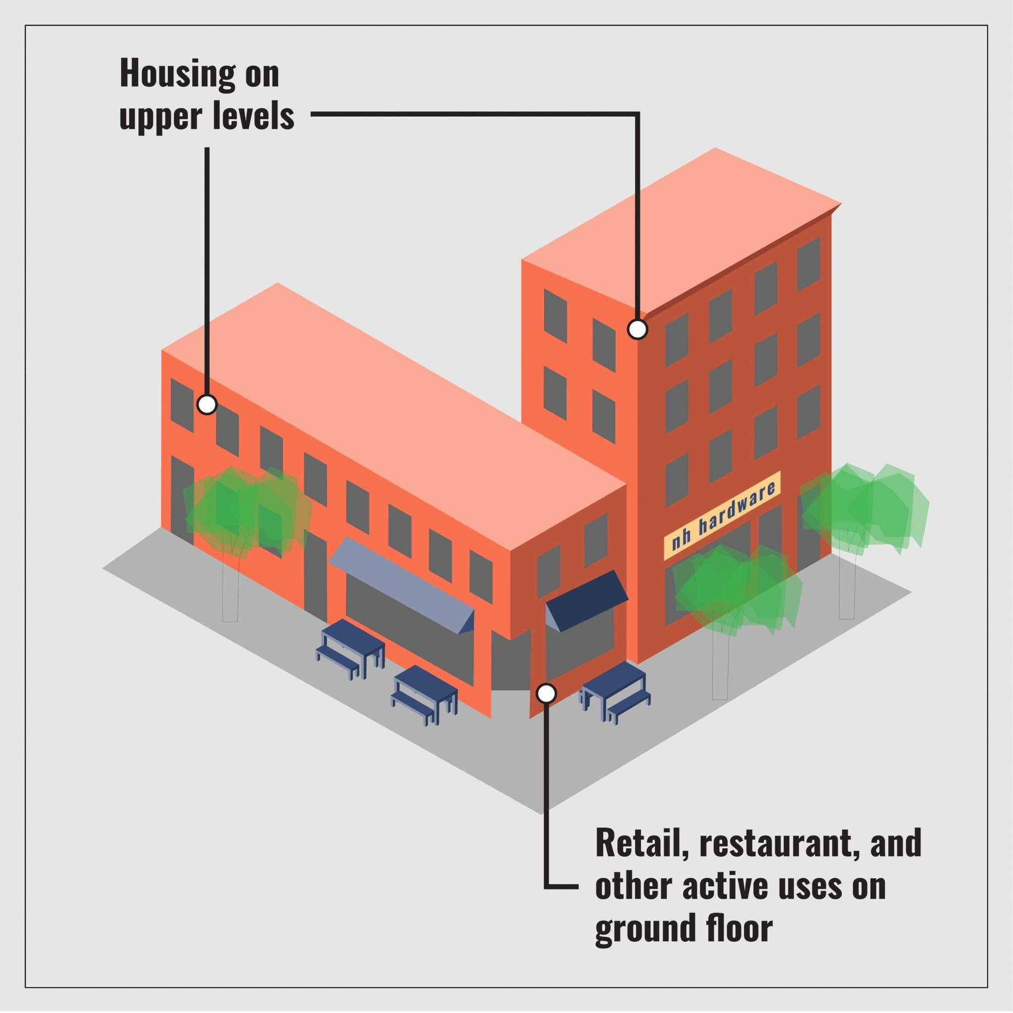
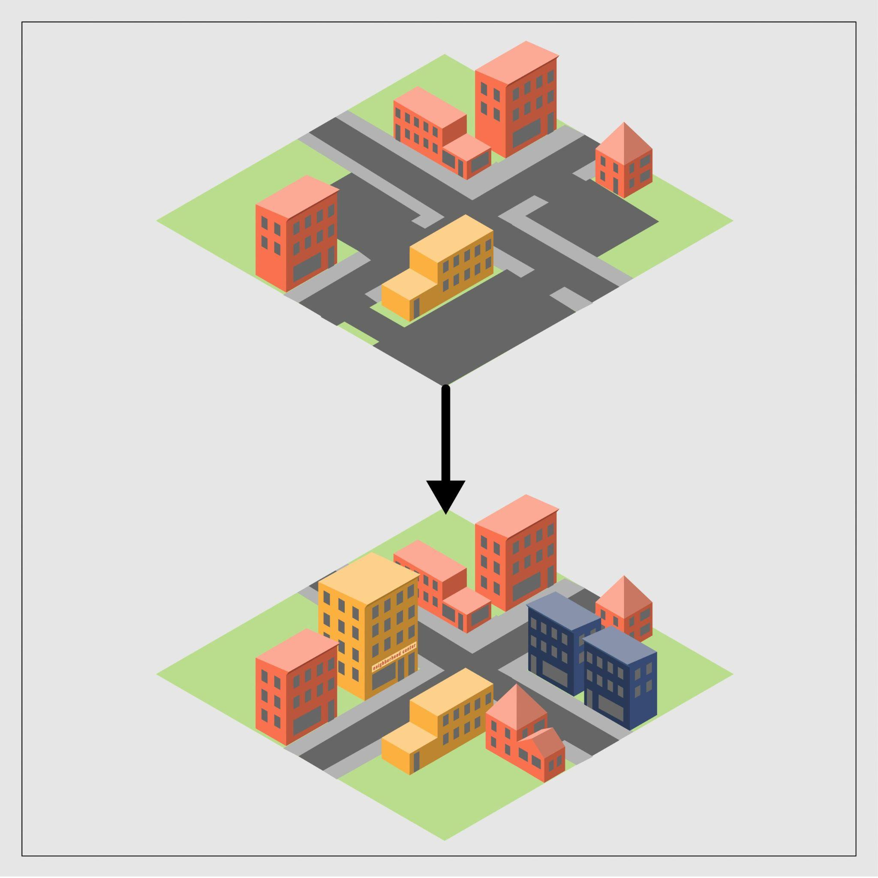
New Hampshire Housing Toolbox: Sustainable Housing
Mixed Use Development
Infill Development
Source: New Hampshire Office of Planning and Development Housing Toolbox

Slide 11
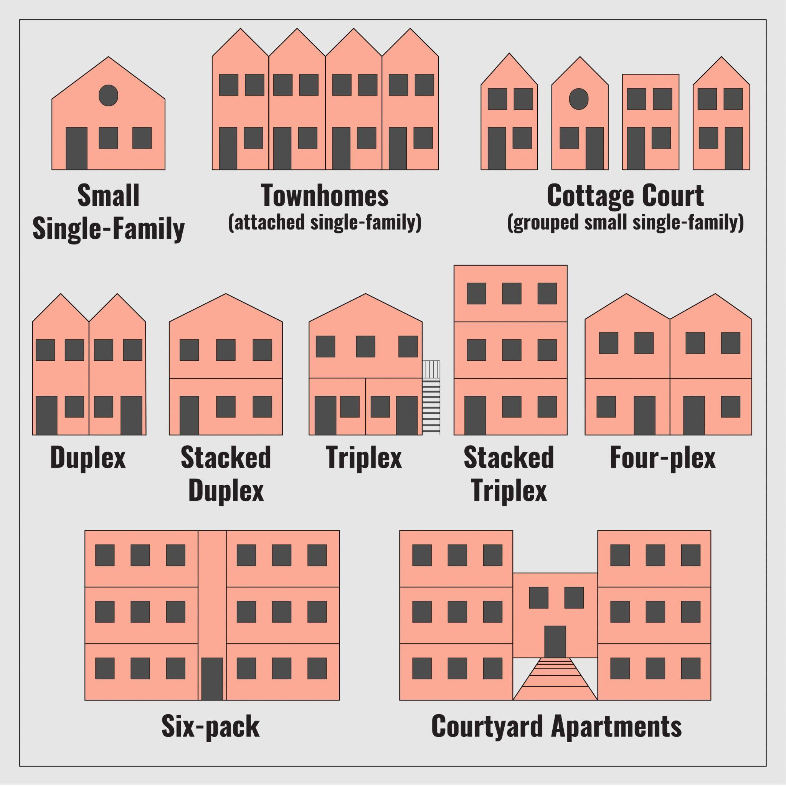
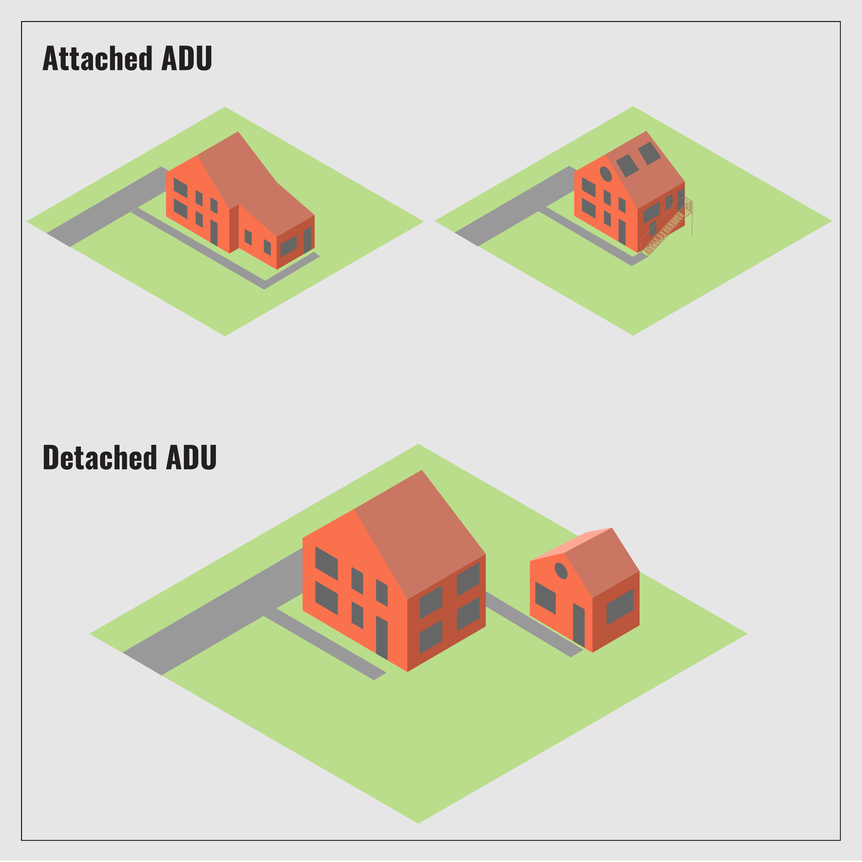
New Hampshire Housing Toolbox: Sustainable Housing
Missing Middle Housing Types
Accessory Dwelling Units
Source: New Hampshire Office of Planning and Development Housing Toolbox

Slide 12
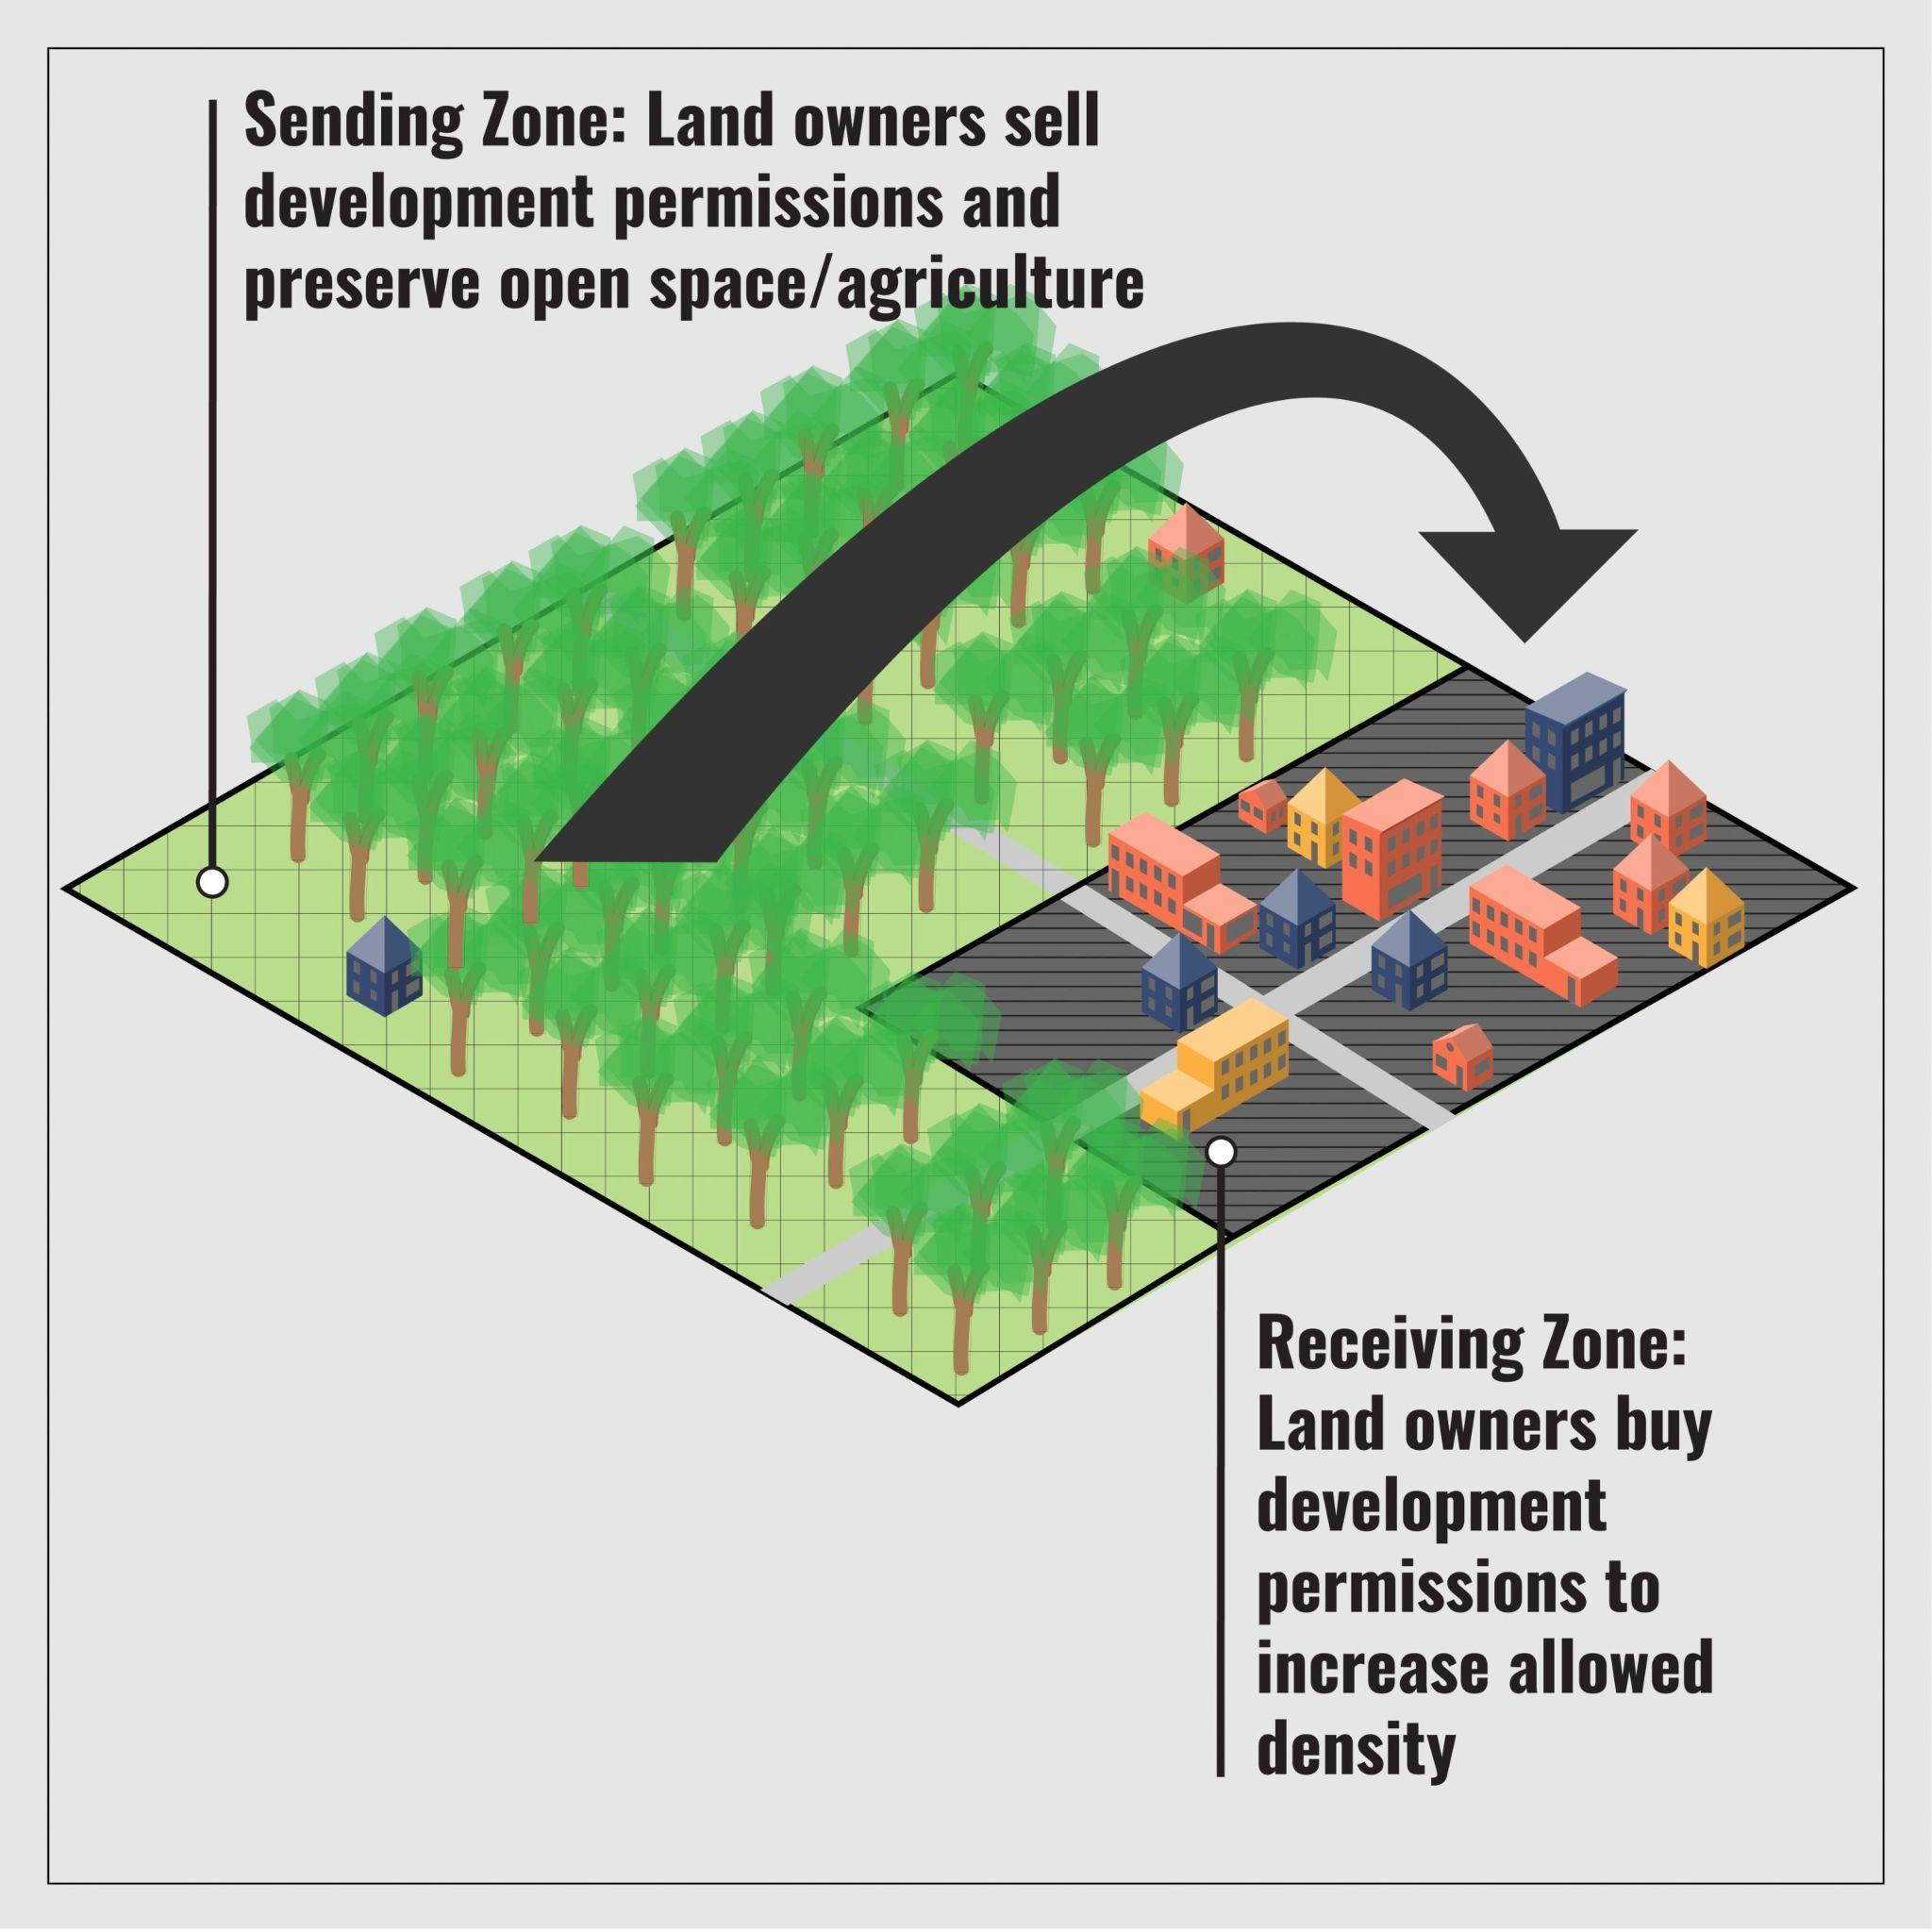
New Hampshire Housing Toolbox: Sustainable Housing
Transfer of Development Rights
Source: New Hampshire Office of Planning and Development Housing Toolbox

Slide 13
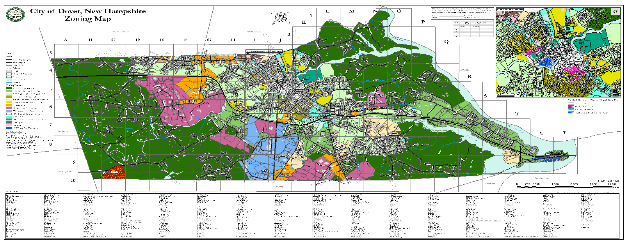
Zone For Density, Not Sprawl
What type of growth do you want to see? Now zone for it.
Local Examples:
Two Accessory Dwelling Units (Dover)
Incentivize Downtown Density (Exeter)
Infill “By-Right" in Growth Zones (Maine)

Slide 14
Easterseals & Forest Society Partnership
Champlin Place & Champlin Forest, Rochester
Property is between the original Easterseals property and the adjoining Forest Society holding
Easterseals sold 120 acres to Forest Society, retaining 21 acres needed to support Easterseals the existing and new Champlin Place.
Champlin Place is new construction of a 65-unit age-restricted project with supportive services
Easterseals applied the sale proceeds to the cost of building Champlin Place
Forest Society celebrates the expansion of the William Champlin Forest

Slide 15
Thank You!
www.seacoastwhc.org
director@seacoastwhc.org
@seacoastwhc

